Slide 1


FIFA World Cup Analysis

Slide 2
Introduction
The FIFA World Cup is a prestigious football tournament that brings together the best football-playing nations from around the world. This analysis aims to uncover key metrics and factors that influence a team's chances of winning the World Cup, using data from the World Cups dataset and the World Cup Matches dataset. Specifically, this report will analyze the following topics: match outcomes by home and away teams, number of goals per country, which countries have won the cup, stadiums with the highest average attendance, goals per team per World Cup, qualified teams, goals, and matches played by teams per year, number of goals per country, and most number of World Cup wins.

Slide 3

Details of Data
The data was obtained from Kaggle, a data science community and platform that provides access to a wide range of datasets for analysis.
Python was used to analyze the data, which allowed for the use of various data analysis libraries to preprocess and analyze the data.
The analysis involved various statistical and data visualization techniques, such as data cleaning, data aggregation, and data visualization, to gain insights into the data.
The data had some limitations, such as missing data or inaccuracies, but these were addressed through careful preprocessing and analysis.
The analysis provides valuable insights into the history and trends of the FIFA World Cup, and can inform further research and analysis in the field of football analytics.

Slide 4
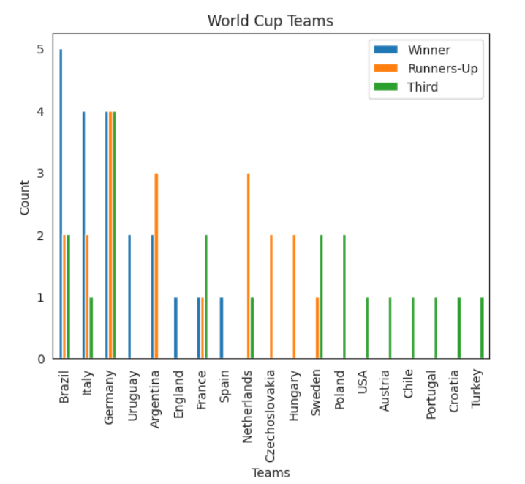

Most Number of World Cup Winning

Slide 5
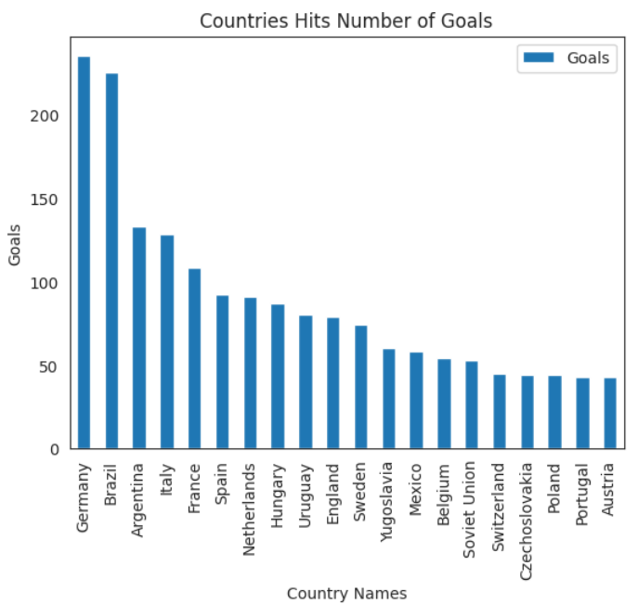
Number of Goal per Country

Slide 6
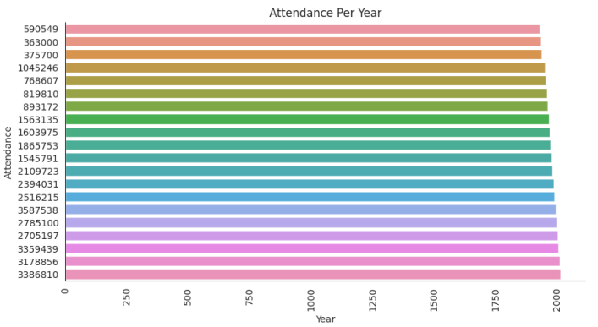
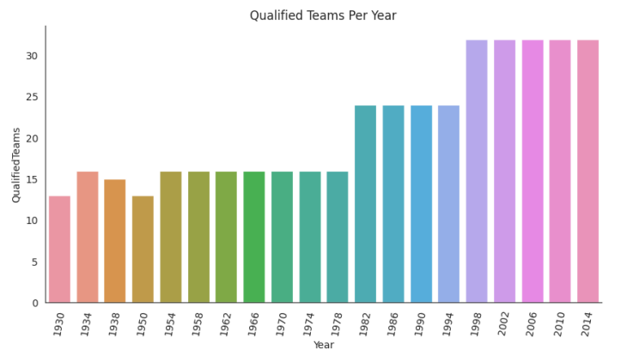
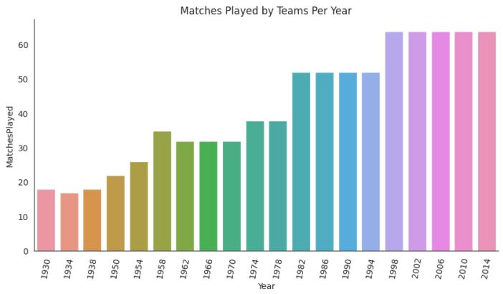
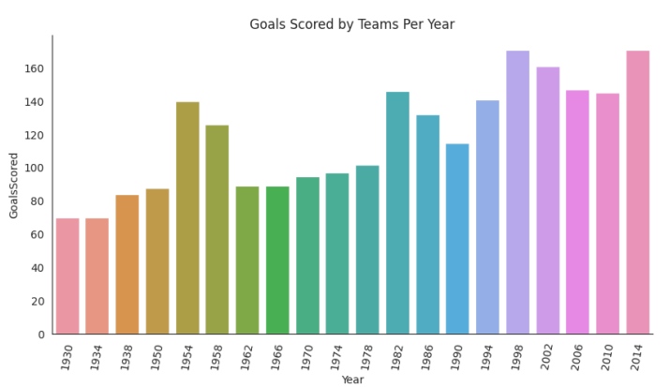
Qualified Teams, Goals, and Matches Played by Teams Per Year

Slide 7
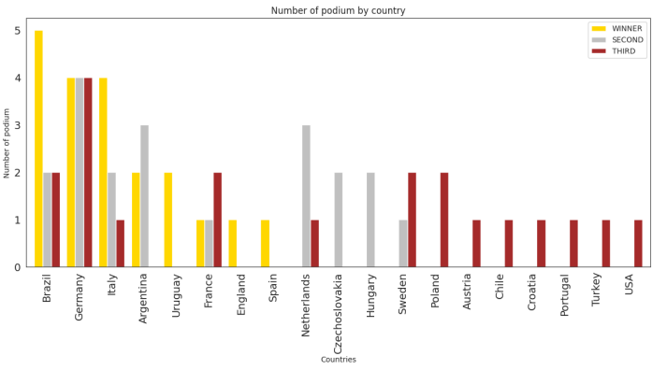
Which countries had won the cup ?

Slide 8
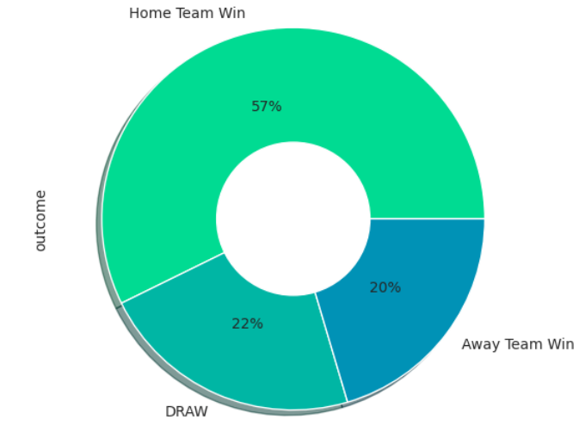
Match outcome by home and away teams

Slide 9
Thank You

